Slide 1

Near protocol

Slide 2
Outline
Protocol Overview
Threshold Proof of Stake (TPoS)
Nightshade
Block structure
Doomslug
Epoch Switch
Data availability
Cross-shard tx
Validation
Slashing

Slide 3
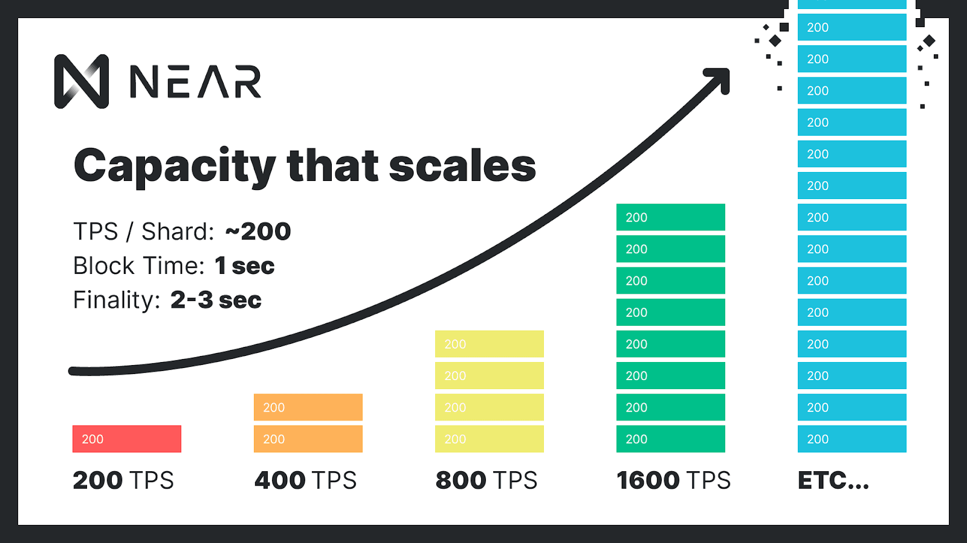
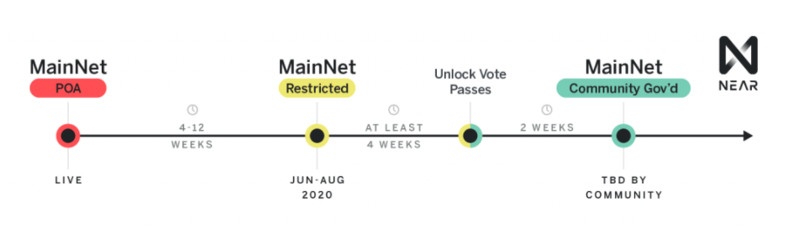
Protocol Overview
Epoch: ½ day block interval: 1s 1 shard: 100 seats
Validator: Block Producer(BP), Chunk Producer(CP), (Hidden Validator), rewards is proportional to uptime and stake
Non-Validator: (Fisherman) (stake 10 NEAR), no rewards
If the validator generated blocks less than 90% of expected, the node will be kicked-out and lose its seat.
Re-stake after 2 epochs, Re-validate after 3 epochs

Slide 4

TPoS (determining the minimum threshold number of tokens for a single seat)
Validator: stake >= seat price
Auction: how many “seats” will be allocated to each prospective validator
With a fixed stake, the more the seat, the lower the price
With a fixed seats, the more the stake, the higher the price
At the end of the epoch T−1, everyone on the network run auction to determine validators for the epoch T+1

Slide 5
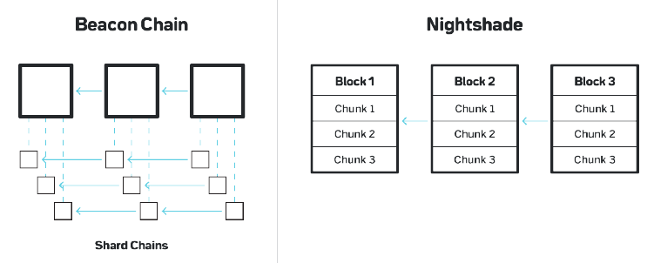
Nightshade (mainchain)
From shard chains to shard chunks, block contains chunks, chunk contains tx
Validator only maintains && validates the state of their corresponding shards

Slide 6
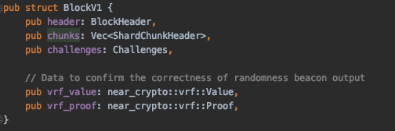
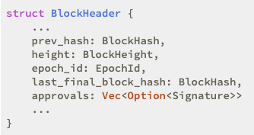
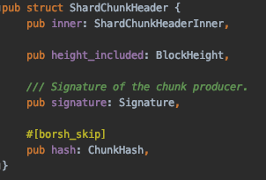

Slide 7
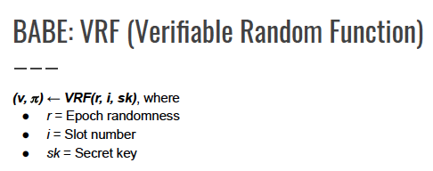
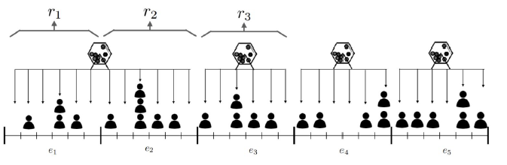
Near VRF:
(v, π) ← VRF(r, sk), where
r = Epoch last block randomness
sk =secret key
Use V to shuffle validator → determine production schedule,
Therefore it doesn’t have multiple-candidates or no-candidates problem

Slide 8
Total 9 seats
Block Producer 6 seats
Hidden Validator 3 seats
Each shard 3 seats
V1 | V1 | V1 | V2 | V2 | V3 | V3 | V4 | V5
V2 | V1 | V3 | V4 | V1 | V2 | V3 | V1 | V5
V2 | V1 | V3 | V4 | V1 | V2 | V3 | V1 | V5
Shard 0
Shard 1
Note: BP & CP cannot be the same guy at the same time, BP has the higher priority
One validator can work for multiple shards

Slide 9
V2
V2
V2
V1
V2
V1
h = 0
V2 -> beacon block
V1 -> shard 0
V4 -> shard 1
h = 1
V1 -> beacon block
V3 -> shard 0
V2 -> shard 1
V1
V3
V1
V3
V4
V4
V2
V2
V2
V1
V2
V1
h = 4
V4 -> beacon block
V1 -> shard 0
V1 -> shard 1
h = 3
V3 -> beacon block
V2 -> shard 0
V4 -> shard 1
V1
V3
V1
V3
V4
V4

Slide 10
Doomslug
Block can be produced in 1 round as long as >⅔ honest BP online
V(h) sends only one of approvals for Block(h):
E(B,v): Endorsement (if received block)
S(h, n, v): Skip n blocks starting at height h
BP(h+1) collects of E or S from >⅔ V(h) and produce Block(h+1)
Finality condition: Block is finalized if at least 2 blocks build on top of it and these 3 blocks have consecutive height
partially synchronous

Slide 11
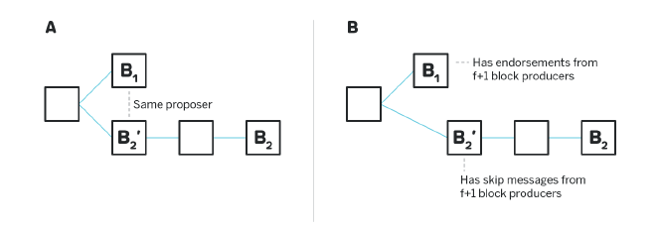
conflicting endorsement:
honest BP can never produce 2 endorsements with the same prev_height
conflicting skip and endorsement:
honest BP can never produce both skip or endorsement for same target

Slide 12
Epoch switches
Epoch starts at height h, epoch length >= 3
h(prev(B)) < h + epoch_length - 3 (if the block is not in the last two blocks of e_cur)
→ Epoch 1, collect ⅔ approval from current epoch
Validator set1
Epo1
Epo2
A
B
C
D
E
F
h h+1 h+2 h+3 h+4 h+5
E.g. epoch_length = 3
Block A: Epoch 1, ⅔ approvals of BP(e_cur)

Slide 13
2. h(prev(B)) >= h + epoch_length - 3 && h(last_final(prev(B))) < h + epoch_length - 3
(if the block is the second last block of e_cur)
→ Epoch 1, collect ⅔ approval from current epoch && ⅔ approval from next epoch
Epo1
Epo2
A
B
C
D
E
F
Validator set1
h h+1 h+2 h+3 h+4 h+5
Validator set2
E.g. epoch_length = 3
Block B: Epoch 1, ⅔ approvals of BP(e_cur && e_next)

Slide 14
3. h(last_final(prev(B))) >= h + epoch_length - 3 (if the block is the last block of e_cur)
→ Epoch 2, collect ⅔ approval from next epoch
Validator set2
Epo1
Epo2
A
B
C
D
E
F
h h+1 h+2 h+3 h+4 h+5
E.g. epoch_length = 3
Block C: Epoch 2, ⅔ approvals of BP(e_next)

Slide 15
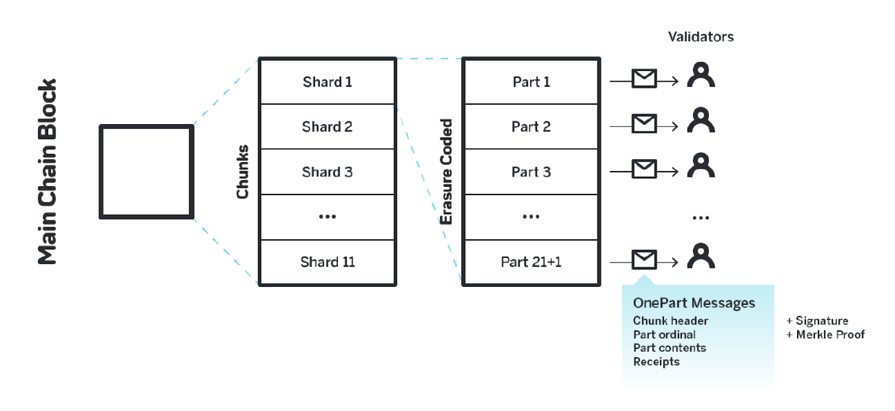
Erasure Code
Since no participant downloads the full state, to ensure the data availability, CP create an erasure coded version of a chunk, ⅙ chunk parts can reconstruct the whole chunk.
Shard0 (part2)
Shard1 (part1)
Shard2 (part4)
...

Slide 16
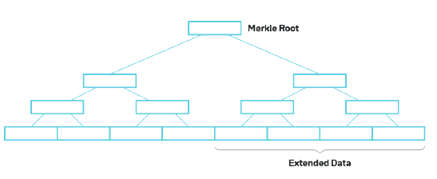
Validator process a main chain block only if they have all onepart messages for each chunk.
Chunk Producers fetche other parts from the peers and reconstructs the chunks they care about.
Chunk Part
n
2n

Slide 17
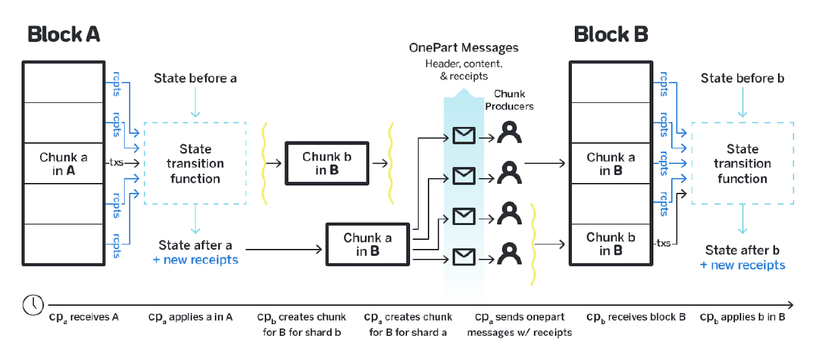
Cross-shard transactions
Producing and storing the receipts. cp_{a} for shard a receives block A, applies tx and generates receipt r. cp_{a} stores all receipts by the source shard id.
https://www.youtube.com/watch?v=mhJXsOKoSdg&list=PL9tzQn_TEuFW_t9QDzlQJZpEQnhcZte2y&index=1

Slide 18
Distributing the receipts. cp_{a} includes receipts into chunk a for block B. Distributes the receipt to the particular BP, who cares about as the destination, in the onepart message.

Slide 19
Receiving the receipts. If block B have all the onepart messages, they have all incoming receipts. Participant apply both the receipts, as well as the transactions.

Slide 20
Block
chunk0
chunk1
chunk2
chunk3
state after prev_chunk
new tx
#6
#7
#8
me
s
s
a
g
e
chunk 0
chunk 0
r
Shard 0
apply
load
Shard 1
chunk 1
apply
load

Slide 21
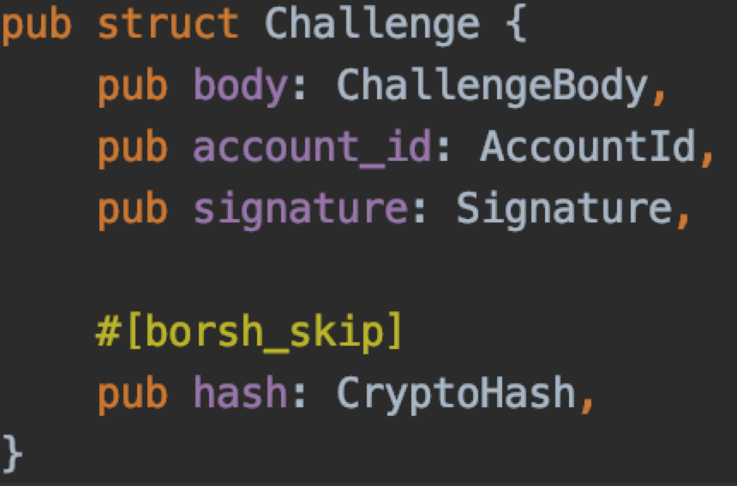
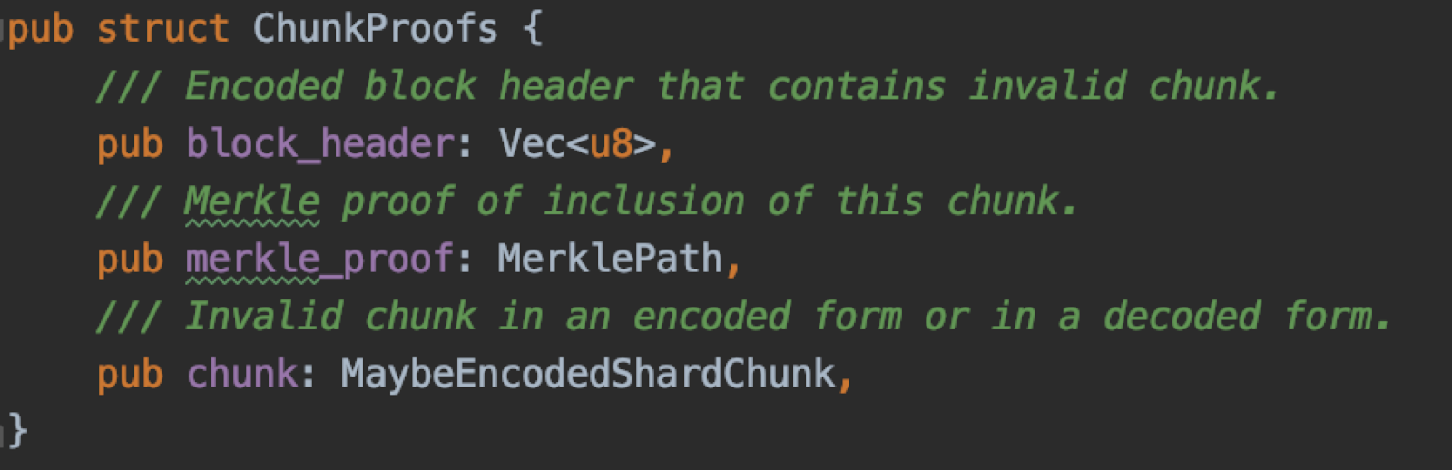
Chunk validation
Chunk can only be validated by the participants that maintain the state.
Limit L_{s} bytes of state that a single tx can cumulatively read / write. Any tx touches more than L_{s} state is invalid. If there is invalid chunk, provide challenge.

Slide 22
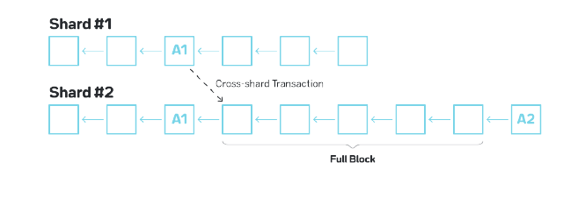
Challenge Period
Cross-shard tx, which is for the destination shard, don’t wait for the challenge period, they apply the receipt immediately, but then roll back if found invalid chunk
About 20 blocks period, fisherman can submit a challenge

Slide 23
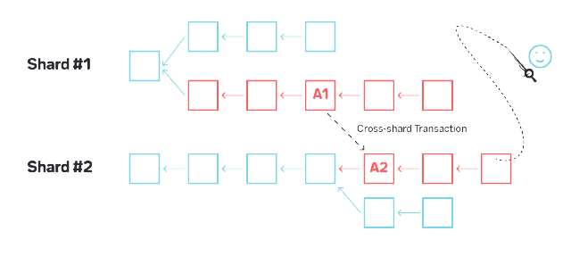
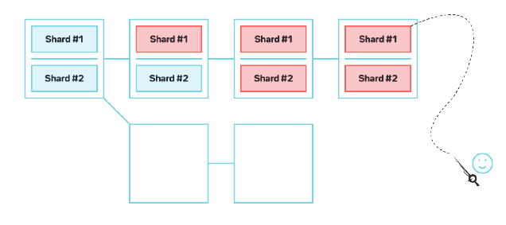

Slide 24
Slash
Double Signing: Signing two or more different blocks at the same height
Invalid Chunks: Signing a chunk with an invalid data or computational result
Since double signing may happens in malicious validators or non-malicious validators, to balance the risk of accidental slashing, NEAR uses “Progressive slashing”
3 * malicious_stake / total_stake
E.g. A has 1 % of the total stake (total 50,000,000, A 500,000).
If A double signs and malicious actors < ⅓, A will lose 3% of his stake in that epoch --> 485,000 returned, 15,000 burned
For invalid chunk, the full stake of the validator gets slashed

Slide 25
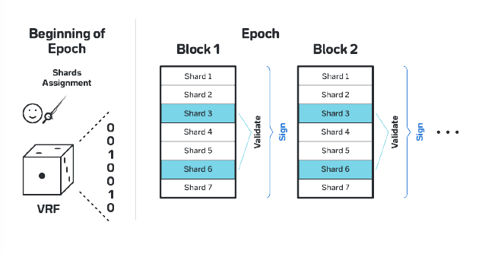
Hidden Validator (WIP)
Since the shards assignment is concealed, HV signs on the full block

Slide 26
Doomslug + NFG
Economics

Slide 27
Outline
Doomslug (paper)
Nightshade Finality Gadget (paper)
Doomslug (in practice)
Economics

Slide 28
Doomslug
Block can be produced in 1 round as long as > 50% honest BP online
V_{i} sends only one of approvals for Block(h):
E(B,v_{i}): Endorsement (if received block)
S(h, n, v_{i}): Skip n blocks starting at height h
BP(h+1) collects of E or S from > 50% V_{i} and produce Block(h+1)
If Block(h+1) includes > 50% E(B_{h},V_{i}), Block(h) has doomslug finality
partially synchronous

Slide 29
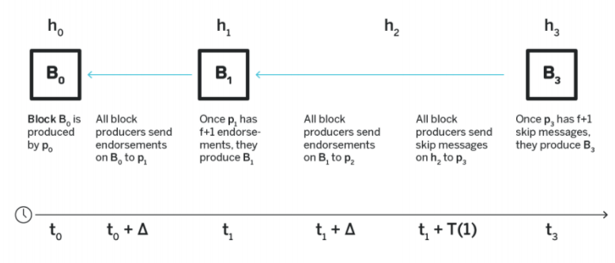
Notes:
Endorsement must be continue height
During Timer, B2 & B3 have to compete. If B3 win, nobody care about B2. only one block has f+1 endorsements

Slide 30
h1
h2
h3
B1
B2
B3
V1
E(B1, V1)
E(B2, V1)
V2
E(B1, V2)
S(h2, 1, V2)
V3
S(h1, 1, V3)
E(B2, V3)
BP at height h3 must collect any combination of
S(h1, 2, BP_{i}), S(h2, 1, BP_{i}), and E(B2, BP_{i}) from > 50% BPs
V4
S(h1, 1, V4)
S(h1, 2, V4)

Slide 31
Safety
A produced block can’t be reverted unless at least one BP is slashed
conflicting endorsement:
Same BP doesn’t propose two blocks for the same height
conflicting skip and endorsement:
A BP can never produce both skip or endorsement for same height

Slide 32
Liveness
A block will be produced in finite time as long as > 50% honest BP online
When BP(h) produces the block without > 50% endorsements, BP(h) would wait for T(h - h_{final}) / 2 (4Δ) between they first received an E or S for height h from an honest V_{i} until BP(h) actually produced the block.
1Δ: all honest V skip or endorse h - 2 to BP(h-1)
2Δ: BP(h-1) collected > 50% messages, produced block at h-1
3Δ: all honest V saw block h-1, and immediately endorse it
4Δ: BP(h) collected endorsement for block at h-1
Therefore, any message sent to BP(h) by any honest V_{i} was an endorsement, and the Block at height h - 1 has doomslug finality in finite time.
partial sync network:
T(h-h_{final}) >= 8Δ
Notes:
Any message send from the first BP to the last BP can be delivered in △,

Slide 33
Nightshade Finality Gadget (NFG)
Block can be finalized in 2 rounds communication as long as >⅔ honest BP online
Straight line voting:
1st round: B’ collects Approval from ⅔ honest BP, quorum pre-vote B
2nd round: B’’ collects Approval from ⅔ honest BP, quorum pre-commit B
partially synchronous
https://www.youtube.com/watch?v=fU7hLt8nJUk&list=PL9tzQn_TEuFW_t9QDzlQJZpEQnhcZte2y&index=7

Slide 34
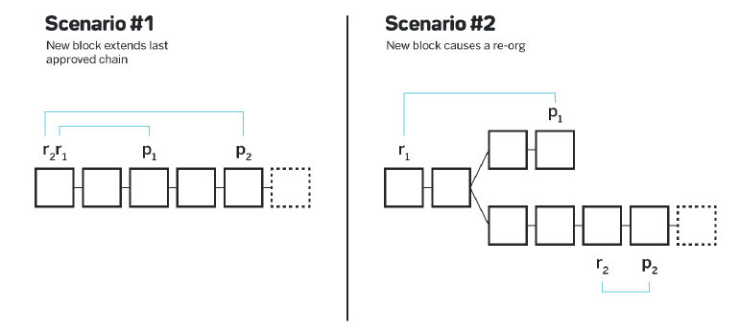
Approval: <v_{i} p_{i} r>
v: Block Producer
p: block is being approved
r: reference block
Same reference block → Same chain
Different reference block → approval not intersect
Approval is produced on doomslug block and canonical chain

Slide 35
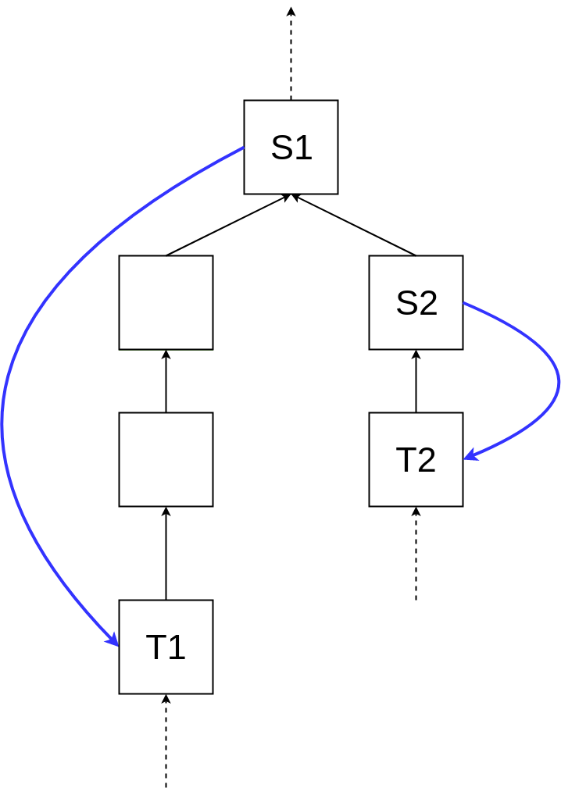
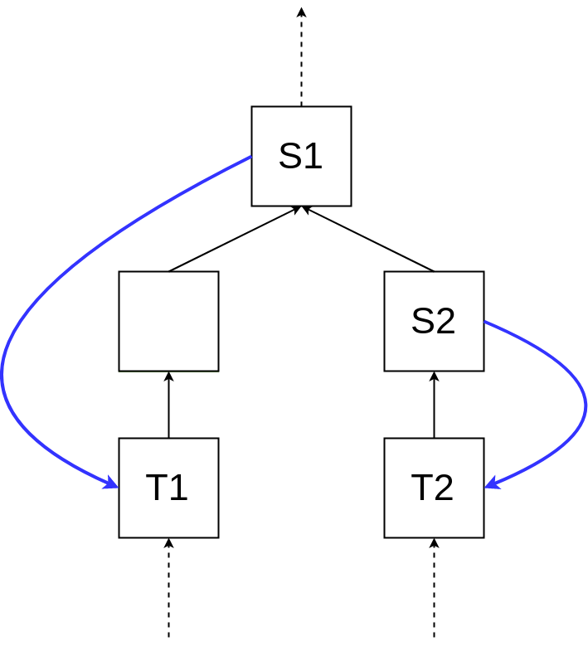
Slashable Approval
1. different chain, same r
3. different chain, intersect approval
r
p1
r
p1
p2
p2
p3
Casper FFG
2. same chain, different r
r
p1
double vote
surrounding vote

Slide 36
NFG (Fork Choice Rule)
Block weight w: w(B) = height of B
Block score s: w(HQV(B)), HQV(B) is the heaviest block that has pre-vote before B
Canonical chain: chain with the higher s(tip) or higher w(tip)
HQV
t1
t2
HQV
t3
t4

Slide 37
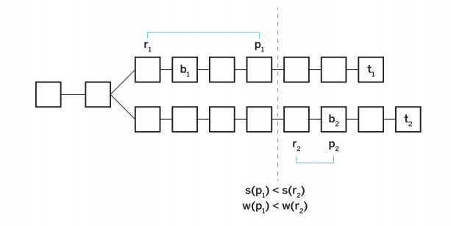
Safety
If a block b1 is finalized in a chain with a tip t1, no block b2 such that w(b2) > w(b1) can have a quorum pre-vote by the same BP set in a chain with some tip t2
Proof: b2 can have quorum pre-vote
B1 finalized, s(p1) >= w(b1)
∵ w(p1) < w(r2), s(p1) < s(r2)
∴ s(r2) >= w(b1)
This means there is b2’ with
weight >= w(b1) ❌

Slide 38
Doomslug in practice
Block includes > ⅔ approvals’ signatures (endorsement, or skip) from other V_{i}
Protocol finality
A block is final if there are two blocks built on top of it and these three blocks have consecutive heights.
h0
h1
G
A
(100)
(0)
B
Send to next
#endorse
#skip
Yellow: Doomslug
Green: Commit

Slide 39
h0
h1
h2
h3
h4
D
(30)
(70)
G
A
(100)
(0)
B
(100)
(0)
C
(100)
(0)
E
Send to next
#endorse
#skip
Yellow: Doomslug
Green: Commit

Slide 40
h0
h1
h2
h3
h4
h5
D
(30)
(70)
G
A
(100)
(0)
B
(100)
(0)
C
(100)
(0)
E
(100)
(0)
F
Send to next
#endorse
#skip
Yellow: Doomslug
Green: Commit

Slide 41
h0
h1
h2
h3
h4
h5
h6
D
(30)
(70)
G
A
(100)
(0)
B
(100)
(0)
C
(100)
(0)
E
(100)
(0)
F
(100)
(0)
G
Send to next
#endorse
#skip
Yellow: Doomslug
Green: Commit

Slide 42
h2
h3
h4
h5
h6
h7
h8
D
(30)
(70)
H
(0)
(100)
C
(100)
(0)
E
(100)
(0)
F
(100)
(0)
G
(70)
(30)
I
Send to next
#endorse
#skip
Yellow: Doomslug
Green: Commit

Slide 43
h2
h3
h4
h5
h6
h7
h9
h10
D
(30)
(70)
H
(0)
(100)
C
(100)
(0)
E
(100)
(0)
F
(100)
(0)
G
(70)
(30)
I
(100)
(0)
J
(100)
(0)
Send to next
#endorse
#skip
Yellow: Doomslug
Green: Commit

Slide 44
h2
h3
h4
h5
h6
h7
h9
h10
h11
D
(30)
(70)
H
(0)
(100)
C
(100)
(0)
E
(100)
(0)
F
(100)
(0)
G
(70)
(30)
I
(100)
(0)
J
(100)
(0)
K
(100)
(0)
Send to next
#endorse
#skip
Yellow: Doomslug
Green: Commit

Slide 45
Economics
Dynamic sharded blockchain allows to maintain a network which almost never has a capacity issues by re-balancing the load based on changing circumstances.
Because of re-sharding, an application (or account) is not defined by the shard it is located in.
Allows all charges to be priced the same, removing the price distinction between crossshard and intra-shard transactions.

Slide 46

Rewards
Rewards is on epoch level, at the end of every epoch, the rewards are then distributed between Validators, Developers and the Protocol Treasury.
epochFees: stateFee + txFee
90% epochReward is used as totalValidatorReward
10% ecpochReward give to Protocol Treasury

Slide 47
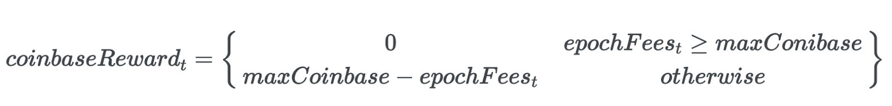
To minimize coinbase, sets a ceiling for the maximum coinbase and dynamically decreases the coinbase depending on the amount of total fees in the system. This ensures a minimum epoch reward, and with growth in usage, reduces inflation.
epochFees_{t} epochFees_{t} >= maxCoinbase
maxCoinbase otherwise
epochRewards =

Slide 48
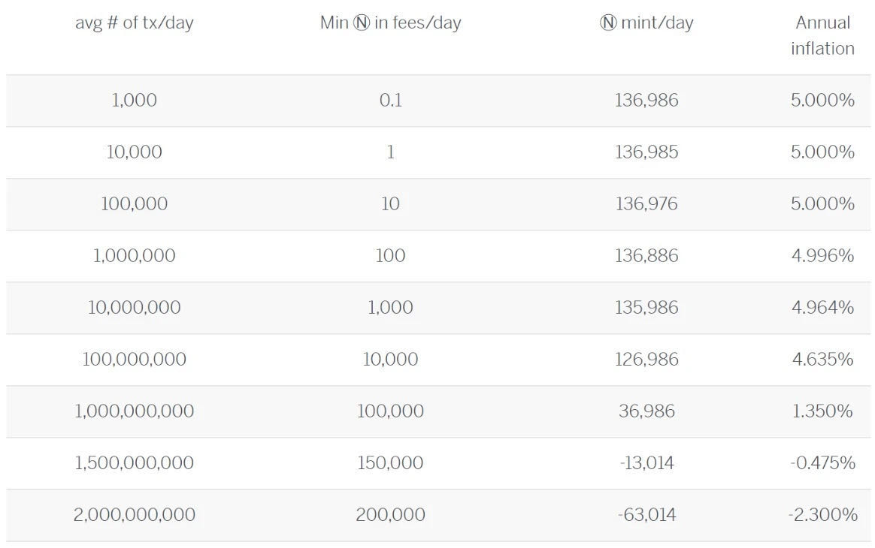
Burns txFee

Slide 49

Transaction Fee
Predict gasFee:
– gasLimitindex, the maximum amount of gas that is allowed in each shard at that index
– gasUsedindex, shard, the amount of gas actually used in each shard at that index
adding a strict expiration (TTL) on transactions to avoid accumulated txs
define minGasPrice to avoid low fee
gasPrice is universal across all shards, if a tx that touches multiple shards, the price is known ahead of time and can easily be calculated. (still needs dynamic resharding to solve imbalance problem of different shard)
Notes:
gasLimit also changed according to validation time

Slide 50
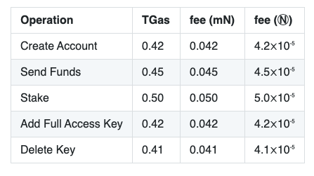

Slide 51
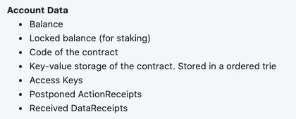
Storage Fee
each block time each account is charged StoragePrice × SizeOf(account) tokens.
minBalance(non-staking): pokeThreshold × storagePrice × SizeOf(account)
minBalance(staking): 4 × epochLength × storagePrice × SizeOf(account)
If account’s balance goes below minBalance anyone can send a special transaction that clears state from this account. As a reward the steward gets some pokeReward of the remaining balance on the account.

Slide 52
update the accounts only when they are already changed by some transaction:
Each account has a StoragePaidAt field.
Current balance is then calculated
balance − StoragePrice × SizeOf(account) × (curBlock−StoragePaidAt).
When account is modified, we recompute the size of the state and update balance given formula above, setting StoragePaidAt at the current block.

